Slide 1
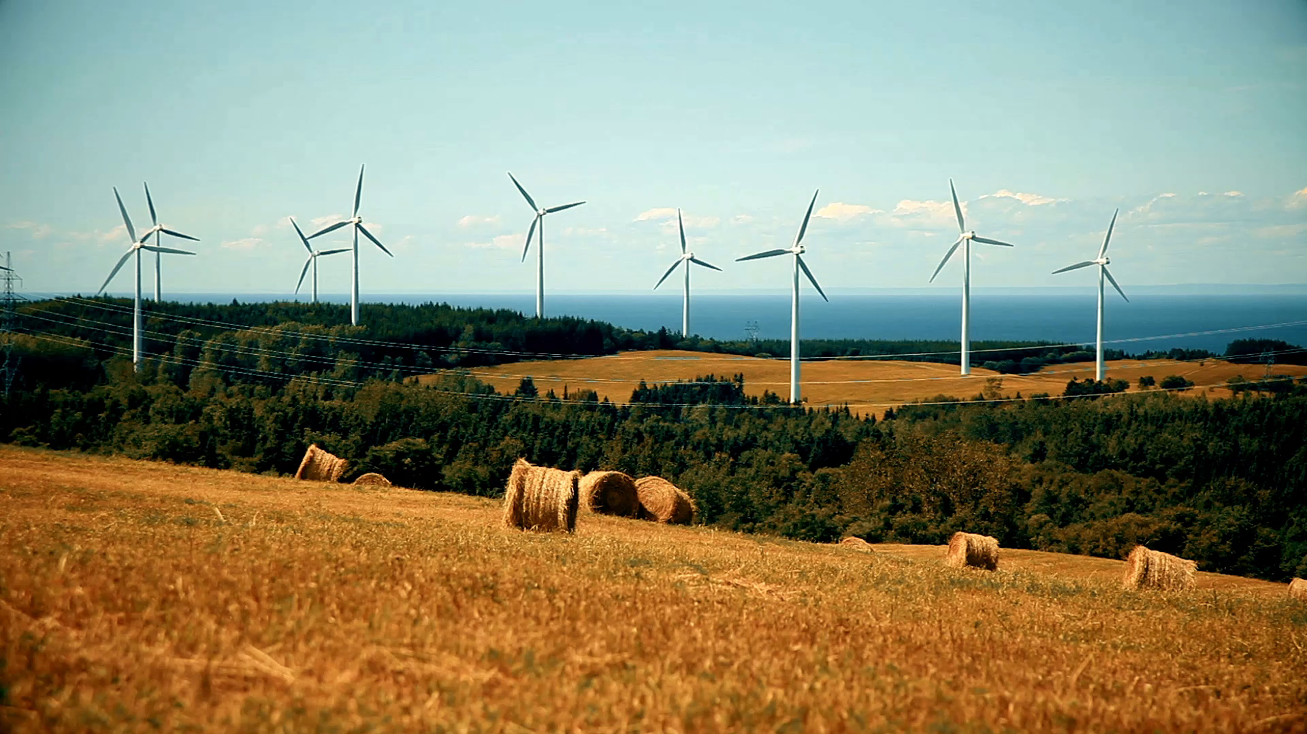
Bachelor’s Thesis Computer Science Probabilistic Short-term Wind Power Forecasting
Johannes Gaus
18.07.2022

Slide 2
Contents
01 Introduction
02 Research Question
03 Approach
04 Results
05 Discussion

Slide 3
01 Introduction
- short abstract and motivation

Slide 4

02 Research Question
- What are the specific research questions to answer?
- Why is this question important to answer?
- which methods to use
- related work and literature review

Slide 5

03 Approach

Slide 6
03 Theretical Approach
- how does Mult Lin Reg work
- how does SVR work

Slide 7
03 Practical Approach
- cleaning the dataset
- which features
- Mult Lin Reg model
- SVR model which kernel, parameters

Slide 8
04 Results
- Evaluation scores
- results

Slide 9
05 Discussion
- conclusion
- discussion
- how good are the models, how useful?
- what to do next, further work

